Slide 1
SDC/SDW Source Code Overview
Leonid Kunin
CVCS Software Team Lead
Leidos

Slide 2
Systems Covered
Situation Data Clearinghouse (SDC)
Consumes Vehicle Situation Data (VSD - BSM bundles) and Intersection Situation Data (ISD – MAP/SPaT) and makes those available via subscription in near real time
Situation Data Warehouse (SDW)
Stores VSD and ISD from SDC and Advisory Situation Data (ASD – TIM) directly for up to 30 minutes and makes those available via query
Separate component also stores VSD and ISD for 9 months
Object Registration and Discovery (ORDS) used to register and discover SDCs, SDWs, and other components

Slide 3
SAE J2735 Extensions
Uses custom UDP interface extensions in the style of J2735 that provide data exchange information in addition to data description provided by SAE J2735
Supports non secure and secure (based on IEEE 1609.2) message exchanges over IPv4 and IPv6
Supports UDP and Websockets interfaces

Slide 4
Software Organization
SDC/SDW uses open source DigitalEdge SaaS platform
High performance Big Data auto scaling ingest pipeline
Originally developed for the Intelligence Community
Parts were declassified and later productized by Leidos
Made Open Source in 2015
Repository at https://github.com/deleidos/digitaledge-platform
All Connected Vehicle related code is implemented as plugins for DigitalEdge (DE)

Slide 5





DigitalEdge SaaS Platform
Setup Tools
Runtime Tools
Data Model Editor
Table Manager
System Builder
Management Console
System Monitor
Public (shared)
Data Models
Dimensions
Parsers
Processors
Data Sinks
Transports
Private
Data Models
Dimensions
Parsers
Processors
Data Sinks
Transports
Scalable, Multi-Tenant
Data
Query Tools
Map-Reduce
Sources
Parse (name/val pairs)
…010011…
Translate (to data model)
…010011…
Process (add enrichment)
…010011…
Hadoop
xml
Alert Engine
Alert Consumers
csv
Lucene
others
Index
Search Tools
custom
+
Others
e.g., Solr
Custom
Custom
Dimension Data
Component Repository
Public Infrastructure
Private Infrastructure

Slide 6
Plug-in Components
Transports – facilitate transferring data from sources into the system
Parsers - translate the input into key-value pairs
Data Models – Simple JSON-based, flexible, multi-version models
Enrichments - perform data or algorithmic enrichments
Data Sinks – Store data, index data for queries, alert on anomalies
A sharable ecosystem can be created for different application domains
Data Models
Transports
Parsers
DigitalEdge
Data Sinks
Enrichments

Slide 7
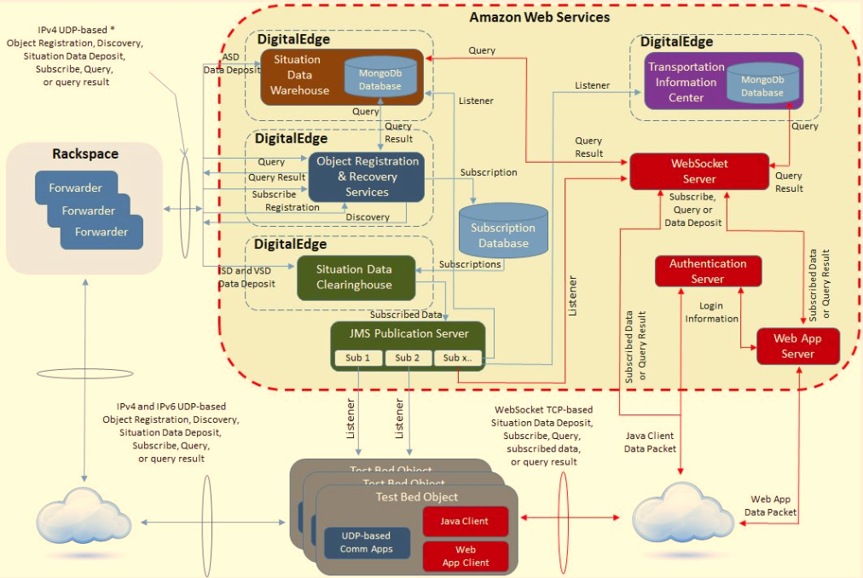
System Architecture Overview

Slide 8
SDC/SDW to RSU/Vehicle Parts

Slide 9
UDP Dialog Interfaces
UDP message exchange sequences
Data deposit for VSD, ISD, ASD
Data distribution for VSD, ISD, ASD
SDC subscription request and cancellation
Service/object registration and discovery
Enclosed in a secure 1609.2 envelope
… or not … at least at the time being

Slide 10
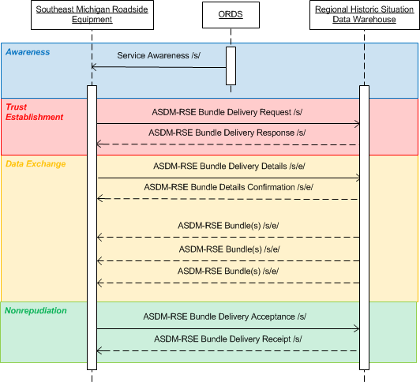
Example: ASD UDP Dialog Sequence
RSU
ORDS
SDW

Slide 11
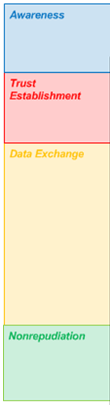
UDP Dialog To DE Plugins Mapping
ORDS System – full UDP dialog in its own right
ServiceRequest
UDP Transport (fedgov-cv-transport-udp)
Security Library (fedgov-cv-security)
Certificate Management (fedgov-cv-security-de)
ServiceResponse
Message Deposit
Parsers (fedgov-cv-parser-j2735)
Enrichments (fedgov-cv-processor-geojson, etc.)
Datasinks:
Subscriptions (fedgov-cv-datasink-subscription)
Data Processing (fedgov-cv-datasink-router)
Query Processing (fedgov-cv-datasink-query-processor)
Service Discovery (fedgov-cv-datasink-object-discovery)
Message Distrib.
DataConfirmation
DataAcceptance
UDP Transport (fedgov-cv-transport-udp)
Security Library (fedgov-cv-security)
Certificate Management (fedgov-cv-security-de)
DataReceipt

Slide 12
Forwarders
DigitalEdge auto scaling makes it dependent on AWS API (or Eucalyptus for private cloud)
AWS does not support UDP over IPv6
Rackspace supports UDP over IPv6 but not AWS API
Implemented message forwarding component that:
Resides in Rackspace
Receives incoming messages in IPv4 or IPv6
Forwards them to DE systems in AWS over IPv4
Receives messages from DE systems in IPv4
Sends them out to the original requestor via IPv4 or IPv6
Implemented as gov.usdot.cv.apps.forwarder package in fedgov-cv-apps project

Slide 13
Source Code Notes
All projects are Maven projects
This is 100% Java implementation
Project names are pretty self explanatory:
All projects start with fedgov-cv-
All transport projects start with fedgov-cv-transport-
All datasink projects start with fedgov-cv-datasink-
Etc.
Javadoc is used as a primary documentation for the source code
JUnit is used for all unit tests
OSS Nakalva ASN.1 for Java is user for all ASN.1 UPER message encoding and decoding

Slide 14
Browse Code

Slide 15
Questions?

